Slide 1

Intro to Concurrency
PASS
CS532: OS Foundations
Lab Assignment
email address: parth2@pdx.edu
partner’s email address:

Slide 2
Instructions: Make a copy of this document, move your copy to your submissions folder and fill the document with your responses. Use the space on each slide to show your responses, and add additional slides as needed.
When ready for grading: complete the lab assignment submission form and include a link to your filled document

Slide 3
helloT.c
Find the helloT.c program linked from the unit course plan document. Read and understand the source code. Read the man pages for all of the pthreads API calls used in the program so that you fully understand the program.
Build and run helloT and confirm that the output is similar to what is described in the source code.

Slide 4
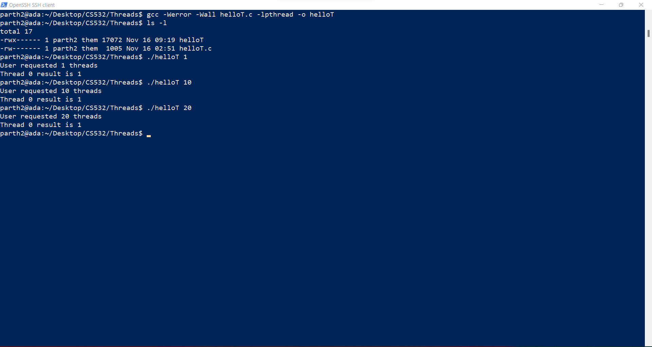

Slide 5
1. Modify your copy of helloT.c so that it creates the correct number of threads and that each thread computes its own unique factorial. Test the code with various input values.
Name your fixed version helloT2.c, upload it to your submissions folder and provide a link to it here (the link below is incorrect and must be changed to link to your helloT2.c program)
Link:- https://drive.google.com/file/d/1kxRBll_g28exoWywX73Aao1jO2GbwyFg/view?usp=sharing
Code looks good

Slide 6
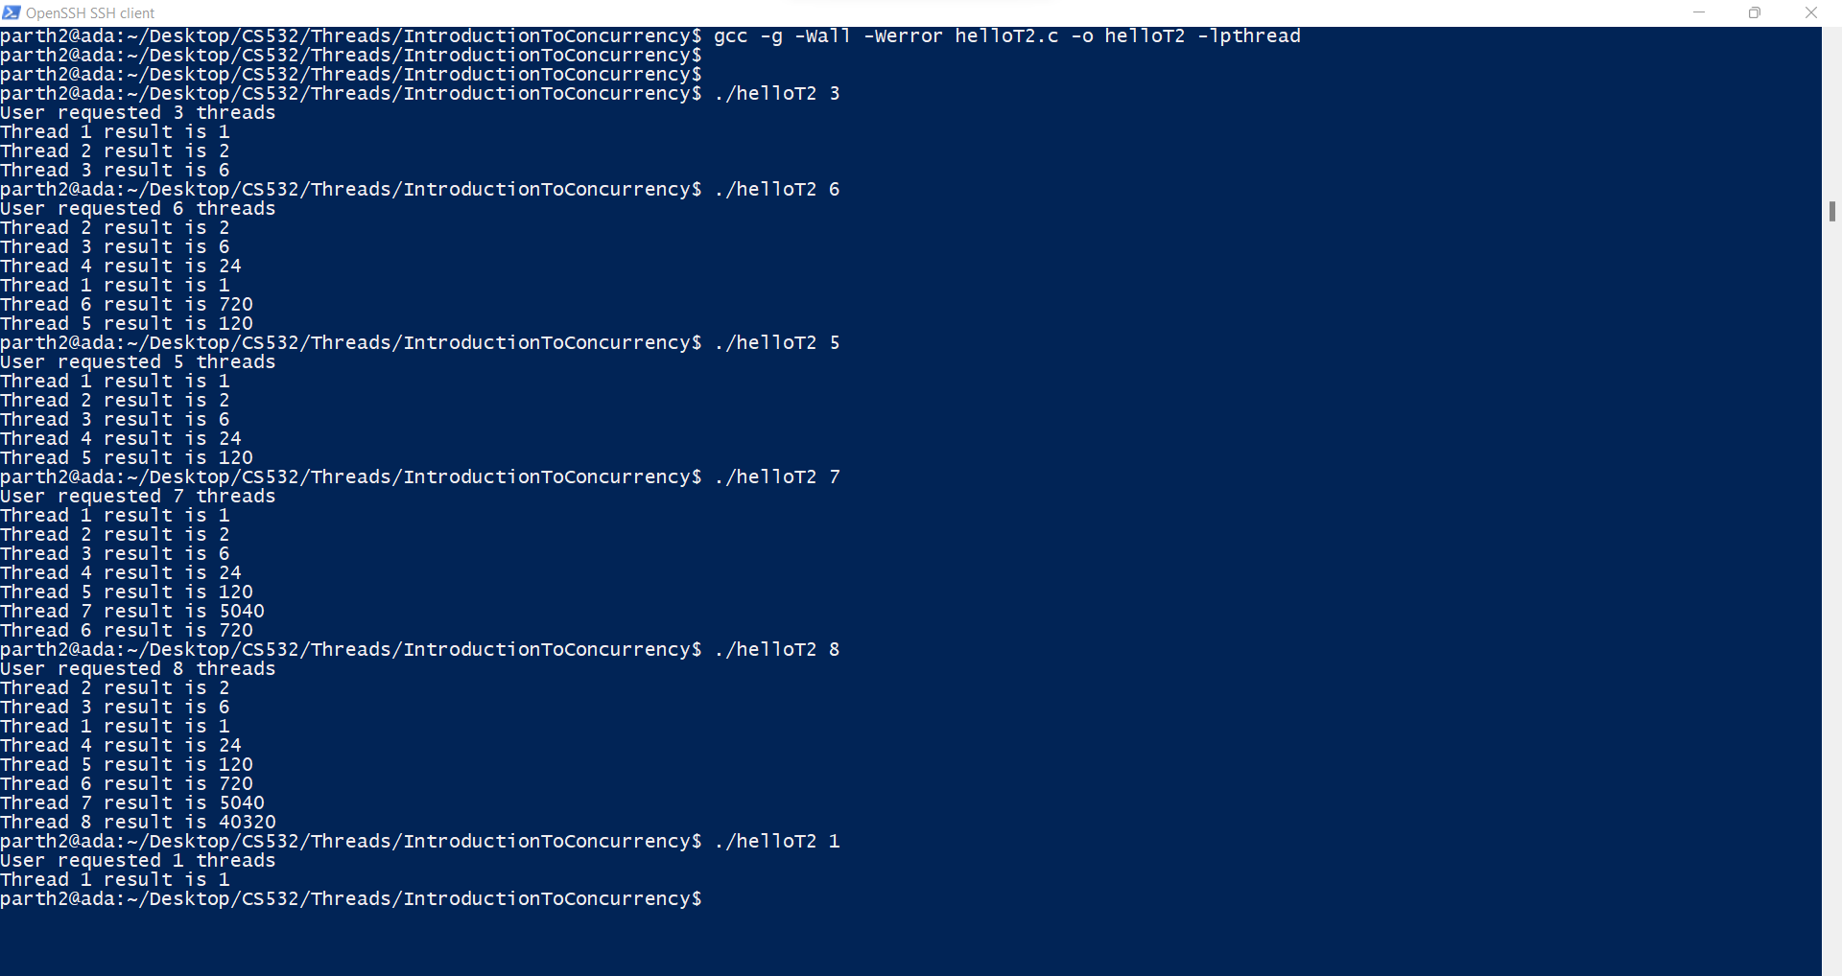

Slide 7
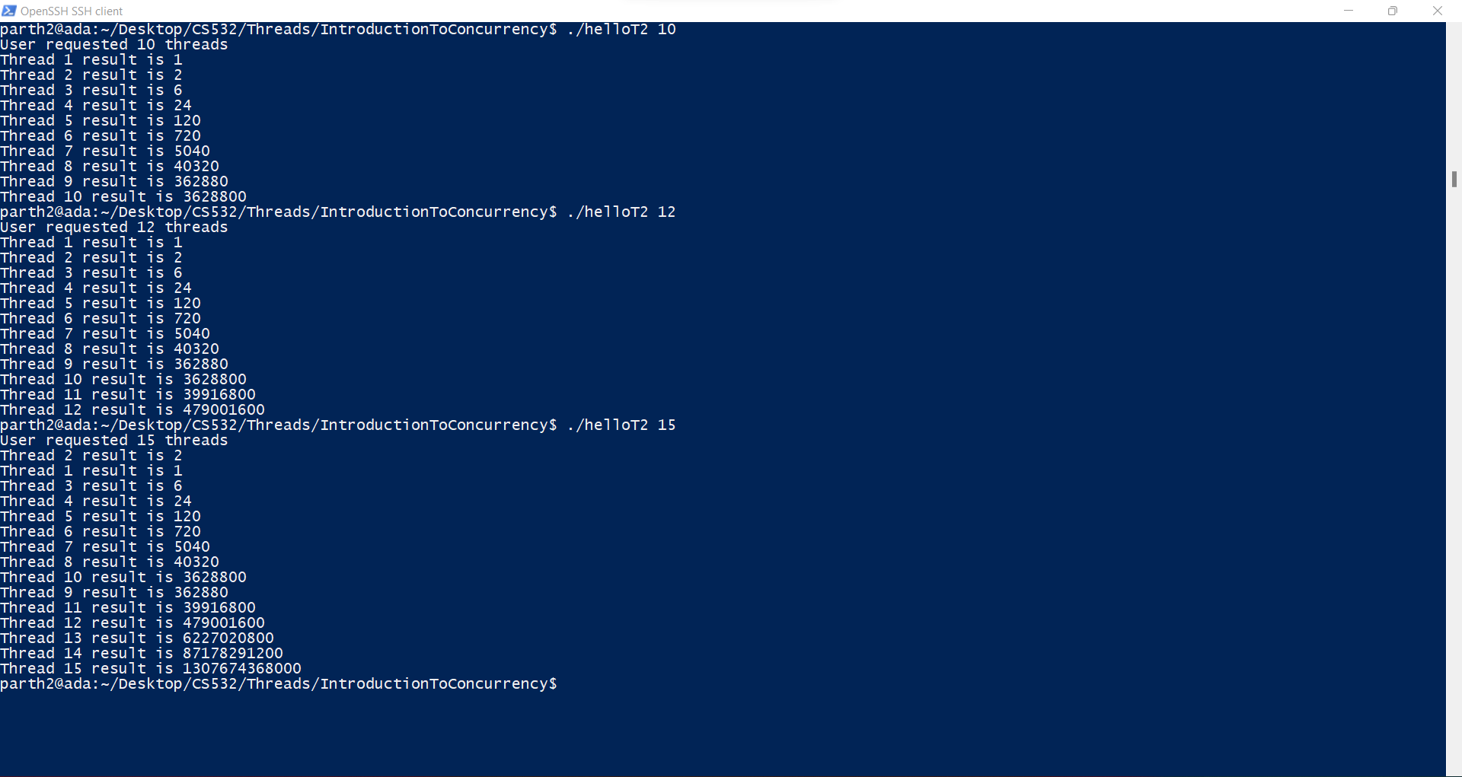

Slide 8
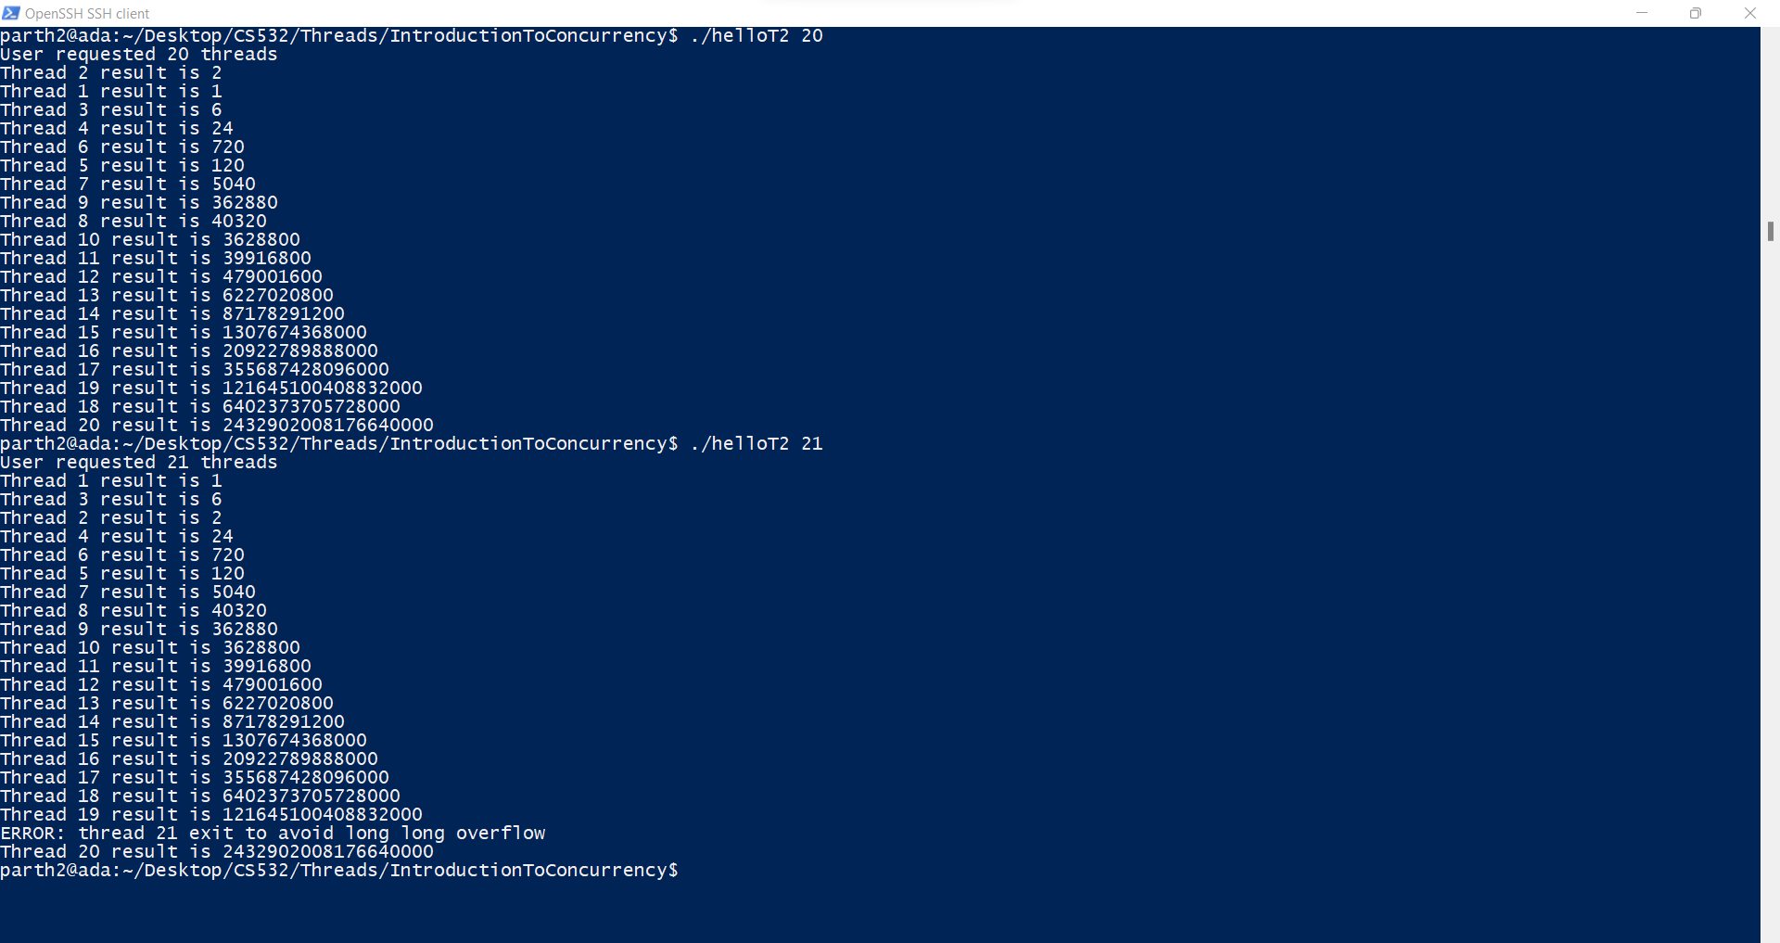

Slide 9
#include <pthread.h>
#include <stdio.h>
#include <stdlib.h>
#include <unistd.h>
#define MAXTHREADS 50
#define SLEEPTIME 5
volatile unsigned long long Total = 0ULL;
pthread_mutex_t mVar=PTHREAD_MUTEX_INITIALIZER;
void *Factorial(void *tidptr)
{
sleep(SLEEPTIME);
int tid = * ((int*) tidptr);
//printf("the value of tid is:- %d\n",tid);
if (tid > 20) {
fprintf(stderr, "ERROR: thread %d exit to avoid long long overflow\n", tid);
return NULL;
}
unsigned long long factorial = 1;
for (int j = 1; j <= tid; j++) {
pthread_mutex_lock(&mVar);
factorial *= j;
pthread_mutex_unlock(&mVar);
}

Slide 10
printf("Thread %d result is %llu\n", tid, factorial);
return NULL;
}
int main(int argc, char *argv[])
{
if (argc != 2) {
fprintf(stderr, "USAGE: helloT <nthreads>\n");
exit(-1);
}
int nthreads = atoi(argv[1]);
if (nthreads < 1) {
fprintf(stderr, "ERROR: numthreads must be >= 1\n");
exit(-1);
}
printf("User requested %d threads\n", nthreads);
int rc;
pthread_t t[nthreads];
int tids[MAXTHREADS];

Slide 11
for (int i = 0; i < nthreads; i++) {
tids[i] = i+1;
rc = pthread_create(&t[i], NULL, Factorial, (void *) &tids[i]);
if (rc){
printf("ERROR; return code from pthread_create() is %d\n", rc);
exit(-1);
}
}
for (int i = 0; i < nthreads; i++) {
rc = pthread_join(t[i], NULL);
if (rc != 0) {
fprintf(stderr, "ERROR joining with thread %d (error==%d)\n", tids[i], rc);
exit(-1);
}
}
exit(0);
}

Slide 12
2. test your helloT program by running the following sequence of commands on your linux system:
rm -f helloT2_out.txt date > helloT2_out.txt
echo ./helloT2 1 >> helloT2_out.txt
./helloT2 1 >> helloT2_out.txt
echo ./helloT2 5 >> helloT2_out.txt
./helloT2 5 >> helloT2_out.txt
echo ./helloT2 15 >> helloT2_out.txt
./helloT2 15 >> helloT2_out.txt
echo ./helloT2 25 >> helloT2_out.txt
./helloT2 25 >> helloT2_out.txt
date >> helloT2_out.txt
Inspect the helloT2_out.txt file to make sure that the program is running correctly. Upload your helloT2_out.txt file to your submission folder and provide a link to it here: https://drive.google.com/file/d/16H6fqab6QaTbWEuMabLXSZAUhuxYJ50r/view?usp=sharing
Output results look OK

Slide 13
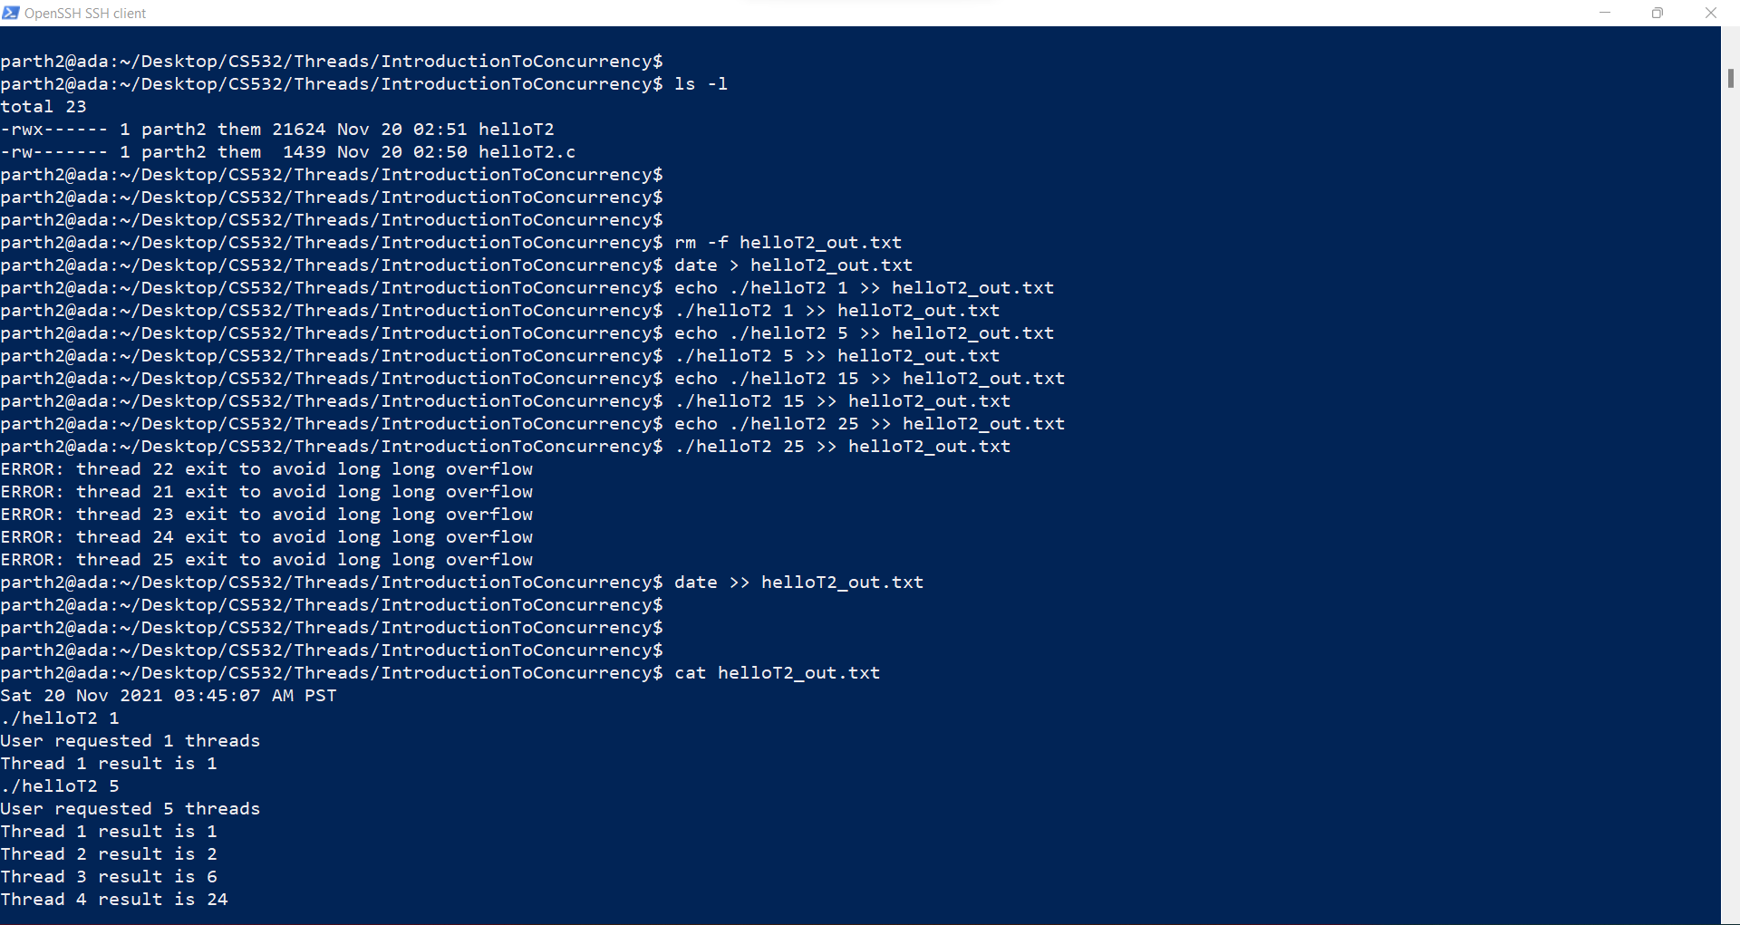

Slide 14
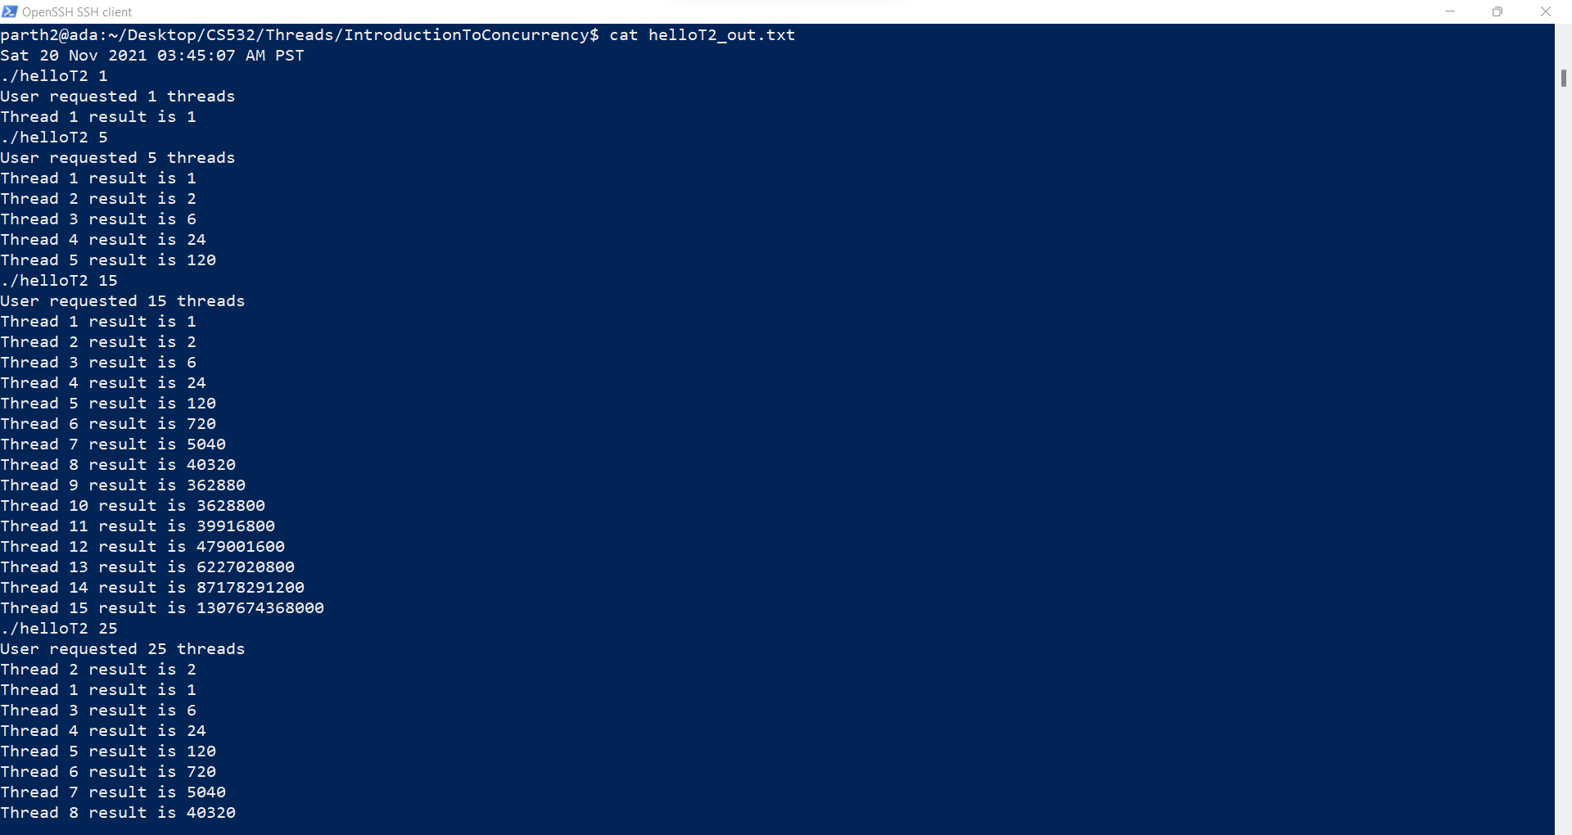

Slide 15
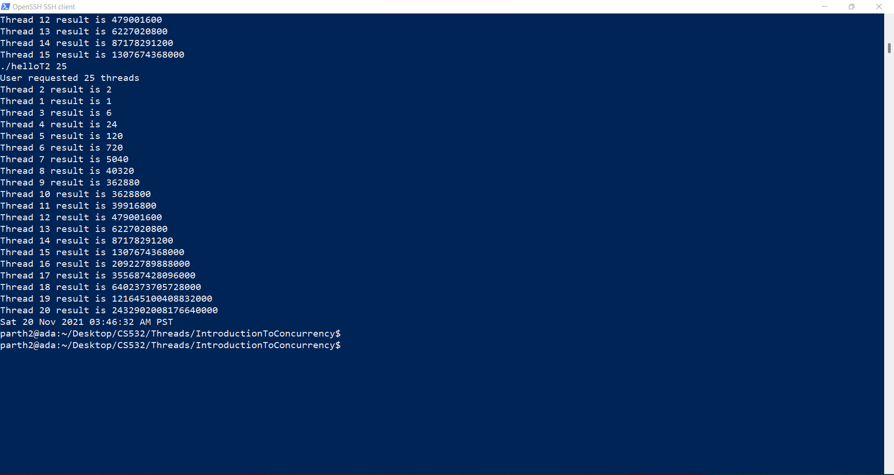

Slide 16
3. Were any parts of this assignment particularly difficult for you? If so, describe the most difficult part of the assignment, for example, the part that required the most effort for you.
The most effort was required to modify the helloT program to conform to the requirements.

Slide 17
4. Before this assignment had you any previous experience writing concurrent software? If yes, then briefly describe your previous experiences.
Yes, I have worked on multi-threaded systems in the past using JAVA as the programming language. I have worked on multi-threaded systems in my professional career with TCS where i had developed concurrent applications using JAVA, Apache Kafka and Apache Ignite.
Good experiences!

